Slide 1



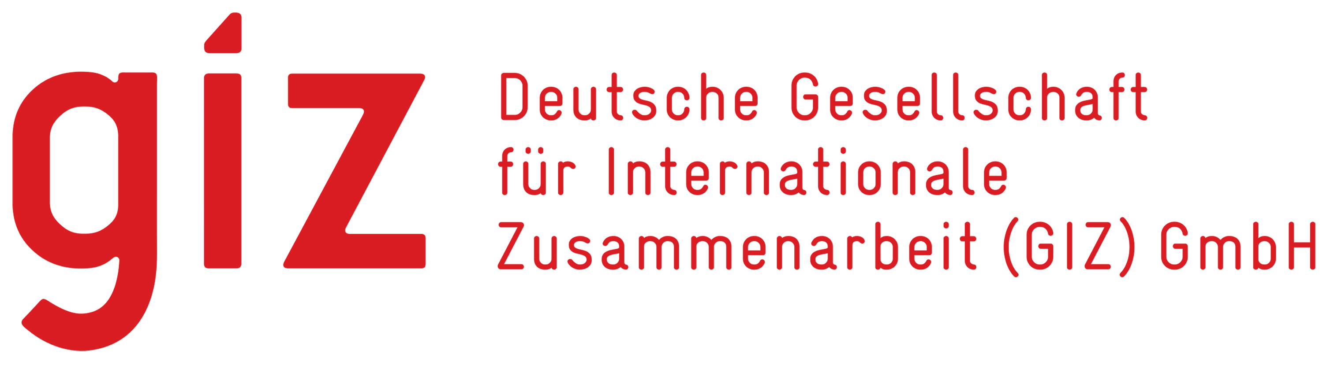
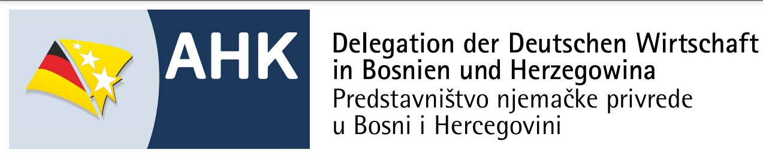
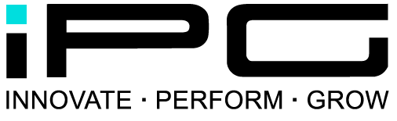
Fit for a Sustainable
Supply Chain in Europe
Program to Strengthen Sustainable Procurement and Supply Chain Capabilities for Companies in Bosnia and Herzegovina
Key Areas of Focus, Methods, and Tools
The programme is co-financed by the European Union and the German Federal Ministry for Economic Cooperation and Development (BMZ) under the Initiative EU for Private Sector Development, and implemented by GIZ in cooperation wit:

Slide 2
Key Topics, Methods, and Tools
Agenda
Topic and Methodology Map
1. European Sustainability Requirements
2. Sustainability Readiness & Strategy
3. Sustainable Category Management
4. Sustainable Supplier Management
5. Sustainable Supply Chain Risk Analysis
6. Decarbonization & Scope 3
7. Digital & AI Tool Guide
8. Transformation Roadmap & Value Contribution
Method Toolkit
Fit for a Sustainable
Supply Chain in Europe
Program to Strengthen Sustainable Procurement and Supply Chain Capabilities for Companies in Bosnia and Herzegovina
Program Partners
Key Areas of Focus | Fit for Sustainable Supply Chain in Europe

Slide 3
Topic and Method Map
The program’s key content at a glance
Readiness
Category
Requirements
Supplier
Maturity & Strategy
Product Category Hot Spots
EU/Customer Requirements
Assessment & Development
Sustainable Procurement &
Supply Chain Transformation
Risk
Roadmap
Supply Chain Risks
Carbon
Digital
Transformation & Value
Scope 3 & Decarbonization
Digital & AI Tool Guide
The Logic: Understand requirements → Assess maturity level → Prioritize areas for action → Manage implementation.
Key Focus Areas | Fit for a Sustainable Supply Chain in Europe
2

Slide 4
1. European Sustainability Requirements
Understanding External Requirements and Translating Them into Corporate Action
Customer Expectations
Regulatory Framework
Objective of This Topic Area
Evidence of environmental and social standards, transparency, risk management, and performance.
Classification of European sustainability and supply chain requirements.
Companies should understand which sustainability requirements arise from European markets, customer relationships, and regulatory developments—and how these requirements influence procurement and the supply chain.
The focus is on understanding sustainability not as an isolated compliance issue, but as an integral part of market positioning, customer capability, and supply chain management.
CO₂ & Climate
Competitiveness
Decarbonization, Scope 3 data, and customer requirements for emissions transparency.
Sustainability as a factor in market access, customer retention, and future viability.
Method: Requirements Mapping – systematically capturing external requirements and applying them to procurement, suppliers, and the supply chain.
Key Topics | Fit for a Sustainable Supply Chain in Europe
3

Slide 5
2. Sustainability Readiness & Strategy
Assess maturity level and develop a vision for sustainable procurement
Sustainability Pulse Check
Strategic Gap Analysis
Target Vision
Assessment of the current maturity level across key dimensions such as strategy, processes, suppliers, data, and organization.
Aligning requirements, ambitions, and existing capabilities—with a focus on prioritized gaps.
Development of a realistic target vision: Which sustainability capabilities should be built?
Governance & Roles
Prioritization
Action Logic
Clarification of responsibilities, interfaces, and decision-making processes in procurement and the supply chain.
Focus on issues with high impact, high risk, or high customer relevance.
Translating strategy into actions, a roadmap, and measurable progress.
Core Method: From Maturity Level to Roadmap—Assess current status, define the target state, and prioritize actions.
Key Areas of Expertise | Fit for a Sustainable Supply Chain in Europe
4

Slide 6
3. Sustainable Category Management
Identify and Prioritize Sustainability Hot Spots by Product Category
Spend & Category Scope
Sustainability Hot Spots
Risk & Opportunity View
Levers & Measures
Category Roadmap
Which product categories are relevant?
Where are the environmental, social, and CO₂ impacts?
What risks and opportunities arise?
Which levers can realistically be implemented?
Which measures are prioritized?
Goal
Methods
Result
Sustainability should be addressed where procurement and supplier management have the greatest impact on risks, emissions, and value creation.
Category Sustainability Screening, Hot-Spot Analysis, Leverage Assessment, Prioritization Matrix, Roadmap Logic.
Specific sustainability measures for each product category—with a focus on impact, feasibility, and customer relevance.
Key Question: Which product groups are most important for sustainable and competitive supply chains?
Key Areas of Expertise | Fit for Sustainable Supply Chain in Europe
5

Slide 7
4. Sustainable Supplier Management
Evaluate, develop, and actively engage suppliers
Supplier Transparency
Assessment & Scoring
Development & Engagement
Structure the supplier base, identify critical suppliers, and collect relevant sustainability data.
Integrate sustainability criteria into supplier evaluation, selection, and regular performance reviews.
Don’t just monitor suppliers—develop, empower, and involve them in improvement measures.
Code & Requirements
Corrective Actions
Collaboration
Define clear expectations regarding environmental and social standards, governance, CO₂ data, and risk requirements.
Address nonconformities, define action plans, and track progress in a measurable way.
Develop joint opportunities for improvement, innovation initiatives, and long-term partnerships.
Core Method: Supplier Sustainability Management Cycle—from requirements through assessment to development and progress measurement.
Key Areas of Focus | Fit for a Sustainable Supply Chain in Europe
6

Slide 8
5. Sustainable Supply Chain Risk Analysis
Understanding Critical Supply Chains and Assessing Risks Beyond Tier 1
Tier 2+
Tier 1
Company
Customer
Raw Materials & Intermediate Products
Direct Suppliers
In-House Production / Value Creation
European customers
Types of Risk
Analysis Methods
Results
Environmental, social, climate, compliance, supply chain, and reputational risks.
Supply chain mapping, risk screening, country/material/supplier risk, criticality assessment.
Prioritized risk areas, transparency needs, and measures to increase resilience and sustainability performance.
Key question: Where do the most significant sustainability risks arise along the supply chain—and how can they be managed?
Key Focus Areas | Fit for a Sustainable Supply Chain in Europe
7

Slide 9
6. Decarbonization & Scope 3
Establishing CO₂ Transparency and Leveraging Reduction Opportunities in Procurement and the Supply Chain
Carbon Basics
Data & Baseline
Reduction Levers
Basic understanding of emissions, Scope 1, Scope 2, and especially Scope 3 in supply chains.
Establishing an initial data foundation covering product categories, suppliers, and relevant emission drivers.
Identification of levers: materials, specifications, supplier development, logistics, energy, and circular economy.
Measure
Prioritize
Engage
Reduce
Track
Identify emission drivers
Assess hot spots
Engage suppliers
Implement measures
Measure progress
Core method: CO₂ hotspot analysis—focusing on areas with the greatest impact and realistic feasibility.
Key Areas of Focus | Fit for a Sustainable Supply Chain in Europe
8

Slide 10
7. Digital & AI Tool Guide
Digital Solutions as Enablers for Transparency, Analysis, and Implementation
Data Foundation
Analytics & Dashboards
Supplier Platforms
Structure data on suppliers, product categories, risks, emissions, and sustainability performance.
Create transparency, identify areas for action, and track progress in a measurable way.
Centrally capture and manage supplier information, assessments, documents, and actions.
Risk Intelligence
AI Support
Tool Selection
Leverage risk indicators, external data, and early warning signals for supply chain management.
Use AI for research, pattern recognition, document analysis, use case development, and decision support.
Evaluate tools based on their benefits, data maturity, integration capabilities, and implementation complexity.
Key Message: Digitalization is no substitute for strategy—it makes sustainable supply chains transparent, manageable, and scalable.
Key Focus Areas | Fit for a Sustainable Supply Chain in Europe
9

Slide 11
8. Transformation Roadmap & Value Contribution
Translating sustainability into concrete implementation, management, and value contribution
1
Ambition
2
Use Cases
3
Measures
4
Roadmap
5
KPIs
Vision & Priorities
Specific Use Cases
Measures & Responsibilities
Timeline & Resources
Progress & Value Contribution
Value Contribution
Governance
Performance Measurement
Sustainability is linked to risks, costs, customer capability, resilience, CO₂ reduction, and innovation potential.
Roles, decision-making processes, data responsibility, and implementation management are defined.
KPIs, milestones, and review processes make progress and impact visible.
Result: A realistic transformation roadmap that integrates sustainability into management decisions and operational implementation.
Key Areas of Focus | Fit for a Sustainable Supply Chain in Europe
10

Slide 12
Method Toolkit
What tools the program provides for practical implementation
Requirements Mapping
Sustainability Pulse Check
Category Hot-Spot Analysis
Supplier Sustainability Assessment
Systematically capture external requirements and translate them into areas of action.
Assess maturity levels and identify strengths, gaps, and priorities.
Evaluate product categories based on sustainability impact, risk, and influence.
Structure supplier requirements, evaluation, and development.
Supply Chain Risk Mapping
CO₂ Hot-Spot Screening
Digital & AI Tool Guide
Transformation Roadmap
Analyze critical supply chains and sources of risk beyond Tier 1.
Identify emission drivers and prioritize reduction levers.
Evaluate tool and data options for transparency, analysis, and scaling.
Consolidate measures, responsibilities, KPIs, and implementation steps.
The methods are deliberately practical: They support analysis, prioritization, implementation, and impact measurement.
Key Areas of Focus | Fit for a Sustainable Supply Chain in Europe
11

