Slide 1


IPG Masterclass
Sustainable procurement
M3 – SUS Category Group Analysis
IPG PARTNERS GROUP

Slide 2
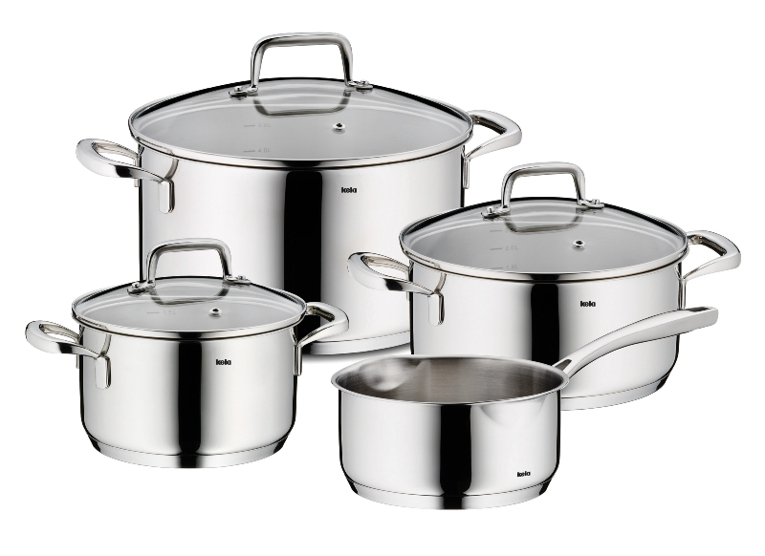

Case Study – BiH Company
BILL OF MATERIAL (BOM) - Cockware
SaraCook
No. | Component | Description / Material | Function / Notes
1 | Pot Body | Stainless steel (AISI 304 / 18-10), aluminum core, or multi-layer base | Main vessel for cooking
2 | Base Disc (Thermal Base) | Aluminum or copper encapsulated in stainless steel | Ensures even heat distribution
3 | Lid (Top Cover) | Tempered glass or stainless steel | Retains heat and moisture
4 | Lid Handle / Knob | Bakelite, silicone, or stainless steel | Heat-resistant grip for safe handling
5 | Side Handles (2x) | Stainless steel, Bakelite, or silicone-coated | Attached to pot body for lifting
6 | Rivets / Screws | Stainless steel | Fixation of handles
7 | Sealing Ring (optional) | Silicone or rubber | For tightly fitting lids (in pressure pots)
8 | Surface Coating (optional) | Non-stick (PTFE, ceramic, or enamel) | For easier cleaning and corrosion resistance
9 | Logo / Brand Marking | Laser engraving or print | Branding element
10 | Packaging | Carton box with labeling and protective inserts | Retail or transport packaging

Slide 3

Case Study – BiH Company
BILL OF MATERIAL (BOM) - Frying Pan
SaraCook
No. | Component | Description / Material | Function / Notes
1 | Pan Body | Cast aluminum, forged aluminum, stainless steel, or carbon steel | Main component for frying
2 | Base Plate (Induction Base) | Magnetic stainless steel (AISI 430) | Enables induction cooking
3 | Inner Coating | Non-stick (PTFE, ceramic, or hard anodized) | Prevents sticking and eases cleaning
4 | Outer Coating / Finish | Heat-resistant lacquer or enamel | Protects surface and enhances aesthetics
5 | Handle | Bakelite, stainless steel, or wood | Ergonomic, heat-insulated grip
6 | Rivet / Screw Fixation | Stainless steel | Joins handle and pan body
7 | Lid (optional) | Tempered glass or stainless steel | Included for covered frying pans
8 | Protective Cap / Insert | Silicone or plastic | Reinforcement at handle connection
9 | Logo / Branding Plate | Laser-marked or embossed | For brand identification
10 | Packaging | Carton or sleeve with manual and label | Ready-for-sale packaging

Slide 4

Case Study – BiH Company
Material MIX - Cockware & Frying Pan
SaraCook
No. | Material Group | Examples of Use | Properties / Purpose
1 | Metals | Stainless steel, aluminum, copper | Excellent heat conduction, corrosion resistance, long lifespan
2 | Non-stick Coatings | PTFE, ceramic, hard anodized coatings | Prevents sticking, improves cooking performance and cleaning
3 | Plastics / Polymers | Bakelite, silicone, nylon | Heat-insulated handles and knobs, ergonomic design
4 | Glass | Tempered glass lids | Heat resistant, transparent for visibility during cooking
5 | Elastomers | Rubber, silicone seals | Used for sealing and insulation (e.g. pressure pots)
6 | Fasteners | Stainless steel rivets or screws | Fixation of handles and assembly stability
7 | Surface Finishes | Enamel, anodized or polished metal | Aesthetic design, anti-corrosion protection
8 | Packaging Materials | Cardboard boxes, inserts, labels | Safe transport, retail presentation, branding

Slide 5
Sustainable procurement – SUS category group analysis
risk assessment – Cockware & Frying Pan – MATERIAL-MIX
SaraCook
Material Category | 1. GHGs / Fossil Use | 2. Resource Efficiency & Recycling | 3. Hazardous Substances | 4. Water Consumption / Scarcity | 5. Packaging Material | 6. Land Use / Biodiversity | 7. Energy Consumption & Efficiency | 8. Non-GHG Emissions | 9. Social Sustainability / Labor | Overall Risk Level
1. Steel & Carbon Steel | 🟠 Medium – CO₂-intensive smelting but regional sourcing | 🟠 Medium – good recyclability; scrap return needed | 🟠 Medium – minor alloying substances | 🟢 Low – limited process water | 🟢 Low | 🟢 Low | 🔴 High – rolling & forming energy intensive | 🟠 Medium – dust & noise in metal forming | 🟠 Medium – fair local conditions | 🔴 High
2. Aluminum & Alloys | 🟠 Medium – moderate fossil energy share | 🔴 High – high recycling potential, but needs closed loop | 🟠 Medium – minor alloy additives | 🟢 Low | 🟢 Low | 🟢 Low | 🔴 High – casting and forging very energy intensive | 🟠 Medium – emissions from melting & quenching | 🟠 Medium – SME labor standards acceptable | 🔴 High
3. Non-Stick / Enamel Coatings | 🔴 High – solvent and curing energy use | 🟠 Medium – limited recycling of coated materials | 🔴 High – PTFE/ceramic chemicals, possible PFAS residues | 🟠 Medium – cleaning and bath use | 🟢 Low | 🟠 Medium – chemical waste risk | 🟠 Medium – curing energy demand | 🔴 High – VOCs and particulates | 🟠 Medium – moderate EHS oversight | 🔴 High
4. Plastics & Elastomers (Handles, Knobs) | 🟠 Medium – petroleum-based | 🟠 Medium – partial recyclability | 🟠 Medium – possible additives (BPA, flame retardants) | 🟢 Low | 🟠 Medium – molded packaging inserts | 🟠 Medium – indirect impact | 🟠 Medium – moderate process energy | 🟠 Medium – VOCs from molding | 🟠 Medium – fair labor locally | 🟠 Medium
5. Glass Lids & Inserts | 🟠 Medium – furnace energy demand | 🟠 Medium – recyclable but fragile | 🟢 Low | 🟠 Medium – water for cooling and cleaning | 🟢 Low | 🟢 Low | 🔴 High – melting temperature >1500 °C | 🟠 Medium – furnace dust and noise | 🟢 Low | 🟠 Medium
6. Fasteners & Auxiliaries (Rivets, Oils, Sealants) | 🟠 Medium – metal & lubricant inputs | 🟠 Medium – partial recovery possible | 🟠 Medium – lubricant chemicals | 🟢 Low | 🟢 Low | 🟢 Low | 🟠 Medium – machining & forming energy | 🟠 Medium – vapors, fumes | 🟠 Medium – workshop labor standards | 🟠 Medium
7. Packaging Materials (Carton, Film, Ink) | 🟠 Medium – fossil and paper inputs | 🟠 Medium – recyclable | 🟢 Low | 🟢 Low | 🔴 High – large packaging volume | 🟠 Medium – forestry sourcing impact | 🟠 Medium – paper and ink energy | 🟠 Medium – VOCs from printing | 🟠 Medium – fair SME labor | 🟠 Medium

Slide 6





Sustainable procurement – pulse check and strategy development
Material criticality assessment
Sprint
Focus on sustainability | Explanatory notes
Greenhouse gases / Use of Fossil energy sources | Greenhouse gases are gases that contribute to the greenhouse effect and can be of both natural and anthropogenic (i.e., human-caused) origin / Emissions related to transportation and livestock farming
Resource efficiency & Circular economy | In contrast to the linear "take-make-dispose" model, the circular economy is an economic model that decouples growth from the consumption of finite resources. The aim is to keep products, components, and resources in cycles and to preserve their value for as long as possible. Specifically, the aim is to: Narrowing - On the one hand, the proportion of primary raw materials is reduced through the use of recycled and renewable materials, and on the other hand, the total amount of material in the cycle is reduced through less use. Slow down - The service life of products and components is extended through maintenance, repair, refurbishment, updates, and upgrades. This preserves value for longer and reduces the need for new materials. Intensify - More output is obtained from the same quantities of materials through more intensive use of products. Close – Materials should be reused for a new purpose at the end of their useful life. Dematerialize – Physical products are replaced by non-physical (primarily digital) products or services.
Hazardous substances | Hazardous substances are substances and preparations/mixtures (solid, liquid, or gaseous) that have one or more hazardous properties and can therefore endanger the life or health of humans and animals, pollute the environment, or damage property.
Water consumption & Water scarcity | Water consumption is colloquially defined as the amount of water used for human consumption. This includes water used for direct human consumption as well as water used for everyday life, agriculture, trade, and industry. Water scarcity occurs when there are insufficient water resources to meet existing water demand.
1
2
3
4
Source: IPG Research

Slide 7





Sustainable procurement – pulse check and strategy development
Material criticality assessment
Sprint
Focus on sustainability | Explanatory notes
Packaging material | Packaging generally refers to the covering or (partial or complete) wrapping of an object, in particular for its protection or for better handling.
Land use/ Preservation of biodiversity | The term "biodiversity" refers to the total diversity of life. The diversity of ecosystems (habitats such as water, forests, alpine areas). The diversity of species (animals, plants, fungi, microorganisms). The diversity of genes (within a species and within the entire ecosystem). Land use (also land use planning) refers to the way in which soil and land (parts of the solid earth's surface) are used by humans.
Energy consumption & Energy efficiency | Energy consumption colloquially refers to the demand for energy for various applications. Energy is necessary to perform work. Depending on the application, a distinction is made between mechanical work, lighting, and heating and cooling processes, which are characterized by time-related measurements and parameters. Energy efficiency is the ratio of the output of services, goods, or energy to the energy input. Energy efficiency is therefore understood as the rational use of energy.
Emissions (excluding GHG*) | Emission of particles, substances, (sound) waves, or radiation into the environment.
Social sustainability / compliance with labor standards and fair business practices | Social sustainability describes the conscious organization of social and cultural systems. Social sustainability should enable a stable society in which all members can participate and which guarantees human dignity, labor rights, and human rights across generations. Combating child labor, forced labor and slavery as well as discrimination
5
6
7
8
9
* GHG = greenhouse gas emissions
Source: IPG Research
Source: IPG Research

Slide 8
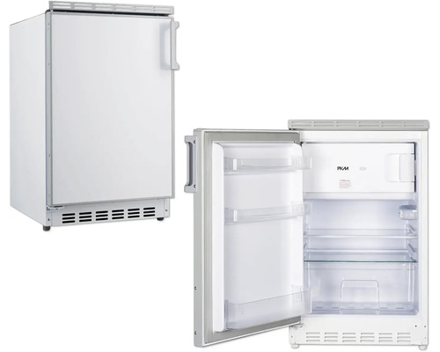
Case Study – BiH Company
BILL OF MATERIAL (BOM) – Refrigerator
BosnaCool
No. | Component | Material / Description | Function / Purpose
1 | Cabinet / Outer Shell | Powder-coated steel or painted sheet metal | Structural housing and aesthetic surface
2 | Inner Liner | High-impact polystyrene (HIPS) or ABS plastic | Hygienic interior surface
3 | Insulation Foam | Polyurethane (PU) foam | Thermal insulation to maintain temperature
4 | Compressor Unit | Hermetically sealed compressor with refrigerant (R600a / R134a) | Circulates refrigerant through the cooling circuit
5 | Condenser Coil | Copper or aluminum tubing | Releases heat to ambient air
6 | Evaporator Coil | Aluminum tubing | Absorbs heat inside the cabinet
7 | Thermostat / Temperature Sensor | Electronic or mechanical control | Regulates internal temperature
8 | Door Assembly | Metal or plastic with magnetic gasket | Provides tight seal and user access
9 | Shelves and Drawers | Tempered glass or plastic | Supports food storage
10 | Lighting Unit | LED module | Interior illumination
11 | Control Panel / Display | Electronic module with buttons or touch interface | Allows user settings and control
12 | Door Gasket | Flexible rubber seal | Prevents air leakage
13 | Feet / Rollers | Plastic or metal supports | Stability and mobility
14 | Refrigerant Piping | Copper tubes | Connects compressor, condenser, and evaporator
15 | Back Cover and Ventilation Grid | Sheet metal or plastic | Protects components and enables airflow
16 | Packaging | Cardboard, protective foam inserts | For transportation and retail protection

Slide 9
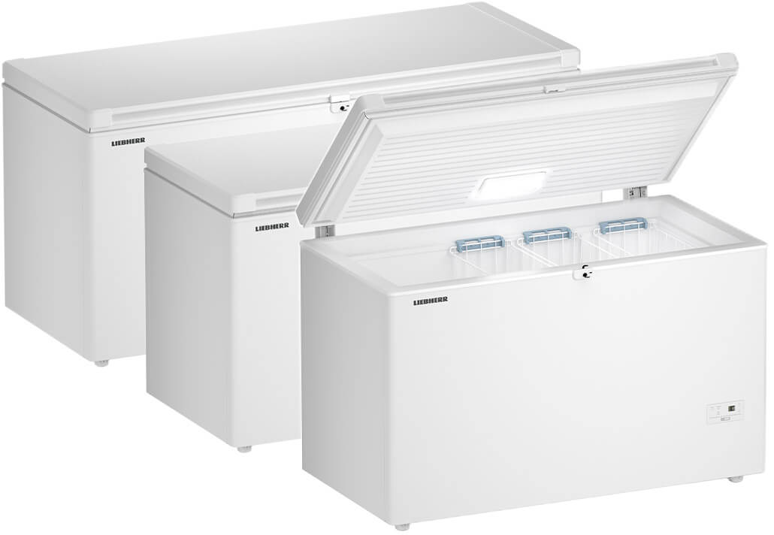
Case Study – BiH Company
BILL OF MATERIAL (BOM) – Freezer
BosnaCool
No. | Component | Material / Description | Function / Purpose
1 | Cabinet / Outer Shell | Powder-coated steel or painted sheet metal | Structural frame and housing
2 | Inner Liner | Aluminum or HIPS plastic | Durable, low-temperature resistant surface
3 | Insulation Foam | High-density polyurethane foam | Thermal insulation for sub-zero temperatures
4 | Compressor Unit | Heavy-duty hermetic compressor (R600a / R290) | Maintains freezing temperature
5 | Condenser Coil | Copper or aluminum tubing | Dissipates heat to the environment
6 | Evaporator Coil | Aluminum tubing or plate | Absorbs heat from internal chamber
7 | Thermostat / Controller | Electronic or mechanical | Maintains consistent low temperature
8 | Lid / Door Assembly | Steel or plastic with magnetic gasket | Ensures airtight closure
9 | Storage Baskets | Coated wire or plastic | Organizes frozen goods
10 | Lighting Unit | LED or fluorescent light | Provides visibility inside
11 | Drain Plug | Plastic with seal ring | For defrost water removal
12 | Door Gasket | Flexible rubber or silicone | Prevents air ingress and frost build-up
13 | Compressor Base / Feet | Metal frame with rubber mounts | Reduces vibration and noise
14 | Refrigerant Lines | Copper tubing | Transfers refrigerant between components
15 | Control Panel / Indicator Lights | Simple on/off and temperature indicators | Displays operation status
16 | Packaging | Reinforced carton and foam padding | Protection during transport

Slide 10
Case Study – BiH Company
Material MIX – Refrigerator & Freezer
BosnaCool
No. | Material Group | Examples of Use | Notes / Characteristics
1 | Metals | Steel (outer shell, frame), aluminum (evaporator, condenser), copper (refrigerant piping) | Durable, corrosion-resistant, excellent thermal conductivity
2 | Plastics & Polymers | HIPS, ABS (inner liners), silicone or rubber (gaskets), polyurethane (insulation) | Lightweight, insulating, moldable, cost-effective
3 | Elastomers | Magnetic door gaskets, seals, vibration dampers | Ensures air-tightness and noise reduction
4 | Electronics | Thermostats, control units, LED lighting | Enables temperature regulation and user interface
5 | Glass | Tempered shelves and panels | Hygienic and visually appealing interior surfaces
6 | Coatings & Paints | Powder coating, enamel, anti-fingerprint finishes | Protection against corrosion, improved aesthetics
7 | Packaging Materials | Cardboard, foam inserts, stretch wrap | Protection during transport and handling

Slide 11
Sustainable procurement – SUS category group analysis
risk assessment – Refrigerator & Freezer – MATERIAL-MIX
BosnaCool
Material Category | 1. GHGs / Fossil Use | 2. Resource Efficiency & Recycling | 3. Hazardous Substances | 4. Water Consumption / Scarcity | 5. Packaging Material | 6. Land Use / Biodiversity | 7. Energy Consumption & Efficiency | 8. Non-GHG Emissions | 9. Social Sustainability / Labor | Overall Risk Level
1. Steel & Metals | 🔴 High – high fossil energy in mining & smelting | 🟠 Medium – recyclable but high losses | 🟠 Medium – exposure to heavy metals | 🟠 Medium – water-intensive mining | 🟢 Low | 🟠 Medium – mining impacts ecosystems | 🔴 High – energy-intensive production | 🟠 Medium – air pollution & particulates | 🔴 High – mining labor risks (Asia/Africa) | 🔴 High
2. Plastics & Polymers | 🔴 High – fossil-based materials | 🔴 High – poor recyclability & degradation | 🟠 Medium – additives & microplastics | 🟢 Low – low direct water use | 🟢 Low | 🟠 Medium – feedstock extraction | 🔴 High – energy demand in polymerization | 🟠 Medium – volatile compounds | 🟠 Medium – factory working conditions | 🔴 High
3. Electronic Components | 🟠 Medium – depends on mix of metals | 🟠 Medium – limited recycling rates | 🔴 High – contains lead, bromine, rare earths | 🟠 Medium – water used in chip production | 🟢 Low | 🟠 Medium – mining inputs | 🔴 High – high power in chipmaking | 🟠 Medium – process emissions | 🔴 High – labor, conflict minerals, EHS risks | 🔴 High
4. Insulation Foams | 🔴 High – often petrochemical origin | 🔴 High – difficult to recycle | 🔴 High – may release HFCs/HCFCs | 🟢 Low | 🟢 Low | 🟢 Low | 🔴 High – energy-intensive chemicals | 🔴 High – VOC and particle emissions | 🟠 Medium – chemical handling risks | 🔴 High
5. Glass Components | 🟠 Medium – fossil fuels for melting | 🟠 Medium – recyclable but energy-heavy | 🟢 Low | 🟠 Medium – moderate water use | 🟢 Low | 🟢 Low | 🔴 High – furnace operations | 🟠 Medium – dust and noise | 🟢 Low | 🟠 Medium
6. Cables & Wiring | 🟠 Medium – metal & plastic inputs | 🟠 Medium – recycling feasible but complex | 🟠 Medium – may contain lead or PVC | 🟢 Low | 🟢 Low | 🟢 Low | 🔴 High – copper & insulation processing | 🟠 Medium – emissions during extrusion | 🔴 High – supplier labor issues | 🔴 High
7. Packaging Materials | 🟠 Medium – fossil-based plastics or paper | 🟠 Medium – partially recyclable | 🟢 Low | 🟢 Low | 🔴 High – packaging volume & waste | 🟠 Medium – forestry or extraction | 🟠 Medium – energy in production | 🟠 Medium – VOCs, dust | 🟠 Medium – working conditions in packaging sector | 🟠 Medium

Slide 12
Sustainable procurement – pulse check and strategy development
Material criticality assessment
Sprint
Focus on sustainability | Explanatory notes
Greenhouse gases / Use of Fossil energy sources | Greenhouse gases are gases that contribute to the greenhouse effect and can be of both natural and anthropogenic (i.e., human-caused) origin / Emissions related to transportation and livestock farming
Resource efficiency & Circular economy | In contrast to the linear "take-make-dispose" model, the circular economy is an economic model that decouples growth from the consumption of finite resources. The aim is to keep products, components, and resources in cycles and to preserve their value for as long as possible. Specifically, the aim is to: Narrowing - On the one hand, the proportion of primary raw materials is reduced through the use of recycled and renewable materials, and on the other hand, the total amount of material in the cycle is reduced through less use. Slow down - The service life of products and components is extended through maintenance, repair, refurbishment, updates, and upgrades. This preserves value for longer and reduces the need for new materials. Intensify - More output is obtained from the same quantities of materials through more intensive use of products. Close – Materials should be reused for a new purpose at the end of their useful life. Dematerialize – Physical products are replaced by non-physical (primarily digital) products or services.
Hazardous substances | Hazardous substances are substances and preparations/mixtures (solid, liquid, or gaseous) that have one or more hazardous properties and can therefore endanger the life or health of humans and animals, pollute the environment, or damage property.
Water consumption & Water scarcity | Water consumption is colloquially defined as the amount of water used for human consumption. This includes water used for direct human consumption as well as water used for everyday life, agriculture, trade, and industry. Water scarcity occurs when there are insufficient water resources to meet existing water demand.
1
2
3
4
Source: IPG Research

Slide 13
Sustainable procurement – pulse check and strategy development
Material criticality assessment
Sprint
Focus on sustainability | Explanatory notes
Packaging material | Packaging generally refers to the covering or (partial or complete) wrapping of an object, in particular for its protection or for better handling.
Land use/ Preservation of biodiversity | The term "biodiversity" refers to the total diversity of life. The diversity of ecosystems (habitats such as water, forests, alpine areas). The diversity of species (animals, plants, fungi, microorganisms). The diversity of genes (within a species and within the entire ecosystem). Land use (also land use planning) refers to the way in which soil and land (parts of the solid earth's surface) are used by humans.
Energy consumption & Energy efficiency | Energy consumption colloquially refers to the demand for energy for various applications. Energy is necessary to perform work. Depending on the application, a distinction is made between mechanical work, lighting, and heating and cooling processes, which are characterized by time-related measurements and parameters. Energy efficiency is the ratio of the output of services, goods, or energy to the energy input. Energy efficiency is therefore understood as the rational use of energy.
Emissions (excluding GHG*) | Emission of particles, substances, (sound) waves, or radiation into the environment.
Social sustainability / compliance with labor standards and fair business practices | Social sustainability describes the conscious organization of social and cultural systems. Social sustainability should enable a stable society in which all members can participate and which guarantees human dignity, labor rights, and human rights across generations. Combating child labor, forced labor and slavery as well as discrimination
5
6
7
8
9
* GHG = greenhouse gas emissions
Source: IPG Research
Source: IPG Research

Slide 14
SUS Category Group analysis & SUS supplier analysis
Sprints
Sprint
M3 – Sprint 1/2
M3 – Sprint 2/2
M4 - Sprint 3
  Material criticality assessment
Which materials contribute most to CO₂ emissions, energy consumption, resource scarcity and all relevant sustainability focus areas defined (1-9)
Plot material groups into the Material Risk Matrix
Derive appropriate mitigation measures for each material group
  Category optimization levers for sustainability
Which category group levers for sustainability do you consider most suitable for your category group?
Which top three levers would you prioritize?
What other stakeholders do you need to implement the top three levers?
What specific measures would you pursue for the top three levers?
What role does purchasing play in each case?
  Supplier measures for sustainability
Which supplier measures for sustainability do you consider most suitable for your category group?
Which top 3 measures would you prioritize?
What other resources do you need to implement the top three measures?
What specific action plan do you intend to pursue for each of the top three measures?
What role does purchasing play in each case?

Slide 15
M3 - Sprint 1/2
DUALIS - Category group – material criticality assessment
Category group – material criticality assessment
To create a Material Heat Map for your product category based on the Bill of Materials (BOM) and known specifications per procurement item, you first need to answer the following key question:
This central question can be broken down into sub-questions such as:
Which materials contribute most to CO₂ emissions, energy consumption, resource scarcity and all relevant sustainability focus areas defined (1-9)
Plot material groups into the Material Risk Matrix
Derive appropriate mitigation measures for each material group
Answering these will allow you to visualize — through the Heat Map and Risk Matrix — in which material sustainability priorities you should focus.

Slide 16
M3 - Sprint 1/2
DUALIS - Category group – material criticality assessment
Category Group (Material group)
A commodity group (or material group) in procurement is a category of goods or services that share similar characteristics, functions, or sourcing strategies.
It helps companies organize and manage their purchases by grouping items with comparable suppliers, markets, or cost structures — for example, “metals,” “electronics,” or “packaging materials.”
Category Group Tree
Category Group
---
SUB-Category Group
…
…
…
Bill of Material
A Bill of Materials (BOM) is a comprehensive list of all materials, components, and parts required to manufacture a product, including quantities and specifications for each item.
It serves as the recipe or blueprint for production, showing how individual components fit together into the final product.
A BOM helps ensure accurate procurement, planning, cost estimation, and inventory management throughout the manufacturing process.
Main article group
…
…
…
…
…
…

Slide 17
DUALIS - Category group – material criticality assessment
Material Risk Matrix
M3 - Sprint 1/2
Assessment of Severity (extent of damage)
6
6 – catastrophic
5 – very high
4 – critical
3 – medium
5
2 – low
1 – very low
4
Severity
Extent of damage
Assessment of Likelihood (probability of occurrence)
3
6 – certain
5 – probable
2
4 – occasional
3 – conceivable
2 – unlikely
1 – inconceivable
1
1
2
3
4
5
6
Likelihood
probability of occurrence
Plot material groups plus Spend volume (3. dimension)

Slide 18
DUALIS - Category group – material criticality assessment
Recommended mitigation measures
M3 - Sprint 1/2
Material Category | Mitigation Measures

Slide 19
SUS Category Group analysis & SUS supplier analysis
Sprints
Sprint
M3 – Sprint 1/2
M3 – Sprint 2/2
M4 - Sprint 3
  Material criticality assessment
Which materials contribute most to CO₂ emissions, energy consumption, resource scarcity and all relevant sustainability focus areas defined (1-9)
Plot material groups into the Material Risk Matrix
Derive appropriate mitigation measures for each material group
  Category optimization levers for sustainability
Which category group levers for sustainability do you consider most suitable for your category group?
Which top three levers would you prioritize?
What other stakeholders do you need to implement the top three levers?
What specific measures would you pursue for the top three levers?
What role does purchasing play in each case?
  Supplier measures for sustainability
Which supplier measures for sustainability do you consider most suitable for your category group?
Which top 3 measures would you prioritize?
What other resources do you need to implement the top three measures?
What specific action plan do you intend to pursue for each of the top three measures?
What role does purchasing play in each case?

Slide 20
M3 - Sprint 2/2
DUALIS - Category optimization levers for sustainability
Category group – Category optimization levers for sustainability
As a strategic buyer at DUALIS, you are responsible for a product group of your choice.
DUALIS has set itself the strategic goal of increasing the sustainability of the products it sells.
You have been tasked, possibly together with other stakeholders, with making your product group more sustainable and aligning your product group strategy with sustainability principles within a cross-functional team.
Which sustainability levers do you consider most suitable for your product group?
Which top three levers would you prioritize?
Which other stakeholders do you need to implement the top three levers?
What specific measures would you pursue for the top three levers?
What role does purchasing play in each of these?

Slide 21

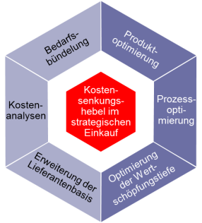

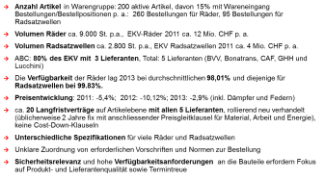
Sustainable procurement - SUS Category Groupanalysis
Roadmap for strategy development and implementation
2
Analysis
Strategy
3
Sustainability analysis
Suppliers (market power)
WG portfolio (risk)
Areas of action
Standard strategies
Purchasing leverage
Strategy portfolio
Commercial levers
Cross-
functional
leverage
Supplier
evaluation
SWOT
S
W
Trend
WG
Procurement market
(Porter's Five Forces)
O
+
+
T
Supplier
Situation
+
CFT experience
Measures
CFT
Strategic measures, overview of potential, implementation schedule
Supplier measures
WG structure
Strategic directions and levers
Supplier
development
Supplier
1 | 2 | 3 | 4 | 5 | 6
X
 | X
 |  |  |  |  | X
 |  |  | X
X |  |  | X
Target agreement
Demand
1
Dates
Potential
Supplier development program
Initial
2
1
2
3
3
4
4
1
5
4
5
S: Strengths W: Weaknesses O: Opportunities T: Threats WG: category groups CFT: Cross-functional team
Results
Source: IPG

Slide 22
20 strategic purchasing levers for sustainability
M3 - Sprint 2/2
Improvement of specifications
Joint value creation
Joint value creation
  S1 Changing specifications to promote sustainability
  S2 Changing product design (e.g. through modularity, reparability, lightweight construction) for greater sustainability
  S3 Innovations: Actively pursuing sustainability innovations among our suppliers
  S4 Demand management: Reduction of demand ("reduce") in product groups with high criticality/high sustainability risks -&gt; Reduction of total material quantity in the cycle through less use
  S5 Reducing resource use: The proportion of primary raw materials will be reduced through the use of recycled and renewable materials ("Reduce")
  S6 Extending service life: Extending the service life of materials, components, and products through maintenance and repair as well as overhaul and reconditioning ("Reuse")
  S7 Intensify use: Get more output from the same amount of materials through reuse, redistribution, and sale of materials, components, and products ("Reuse")
  S8 Upcycling of products: Creative and sustainable use of old and used materials, components, and products at the end of their useful life to create new products of higher value or better quality ("Recycle")
  S9 Recycling: Parts or materials are recovered from the product for reuse ("recycle").
  S10 Dematerialization: Physical materials, components, and products are replaced by non-physical (primarily digital) products or services
  W1 Make the entire value creation process more efficient in line with sustainability goals
  W2 Make logistics more sustainable, e.g., fewer emissions, fewer kilometers, etc. (e.g., from global to local sourcing)
  W3 Change supply chains, e.g., vertical integration*, to achieve greater transparency
  W4 Supplier qualification: Implement qualification measures for sustainability
  W5 Intensify supplier relationships: Get to know suppliers better and build relationships that are more focused on sustainability
  W6 Performance-based contracting: Programs that offer suppliers incentives to develop more sustainable concepts
  W7 Lobbying: Introduction and enforcement of new political measures to promote sustainable behavior
  W8 New procurement markets: Moving away from geographical sustainability hotspots
  W9 Cooperative partnerships for sustainability with suppliers
  W10 Focus on certifications and sustainability standards in purchasing
"Develop advantages"
Bottleneck
parts
Bottleneck
suppliers
Strategic parts
Key suppliers
high
Supply risk
/market power of suppliers
Standard
parts
Non-critical
suppliers
Lever
parts
Lever
Suppliers
low
low
high
Market power of buyers
Influence on buyers
* Vertical integration refers to a form of corporate concentration in which the vertical range of manufacture is increased by merging several companies with successive stages of processing or trade. Vertical integration is therefore also referred to as vertical corporate concentration.
Suitable for ABC
Top 3 levers for ABC
Source: IPG

Slide 23
20 strategic purchasing levers for sustainability
M3 - Sprint 2/2
Additional specialized material-sustainability databases (1/4)
No. | Improvement of specifications 1/2 | Description
S1 | Changing specifications to promote sustainability | Changing specifications to promote sustainability means reviewing and adjusting product or material requirements to reduce environmental and social impact. For example, it can include switching to recycled materials, reducing packaging, using energy-efficient components, or designing products for longer life and easier recycling. This lever helps companies make their procurement and production more sustainable without compromising functionality or quality.
S2 | Changing product design (e.g. through modularity, reparability, lightweight construction) for greater sustainability | Changing product design for greater sustainability means improving how a product is built to reduce its environmental impact over its entire life cycle. This can include using modular designs for easy repair or upgrade, lightweight construction to save materials and energy, and designing for durability or recyclability. The goal is to make products that use fewer resources, last longer, and create less waste.
S3 | Sustainability innovations: Actively pursuing sustainability innovations among our suppliers | Innovations: Actively pursuing sustainability innovations among our suppliers means working closely with suppliers to develop new, more sustainable materials, technologies, and processes. This can include co-creating low-carbon solutions, improving resource efficiency, or introducing circular products. The goal is to drive continuous improvement and make sustainability a shared source of innovation and competitive advantage across the supply chain.
S4 | Demand management: Reduction of demand ("reduce"), Reduction of total material quantity | Demand management: Reduction of demand ("reduce") means lowering the total amount of materials or products used — especially in categories with high environmental or social risks. This can be achieved by using products more efficiently, extending their lifespan, or avoiding unnecessary consumption. The goal is to reduce the overall material flow in the value chain and minimize negative sustainability impacts.
S5 | Reducing resource use: The proportion of primary raw materials will be reduced through “secondary material” (recycled and renewable) | Reducing resource use means lowering the amount of primary (new) raw materials needed by using recycled or renewable materials instead. This approach helps to save natural resources, decrease waste, and cut carbon emissions — supporting a more circular and sustainable material cycle.

Slide 24
20 strategic purchasing levers for sustainability
M3 - Sprint 2/2
Additional specialized material-sustainability databases (2/4)
No. | Improvement of specifications 2/2 | Description
S6 | Extending service life: Extending the service life of materials, components, and products ("Reuse") | Extending service life means keeping materials, components, and products in use for as long as possible through regular maintenance, repair, refurbishment, or reconditioning. This reduces waste, conserves resources, and lowers environmental impact by avoiding the need for new production (“Reuse”).
S7 | Intensify use: Get more output from the same amount of materials through reuse, redistribution, and sale of materials, components, and products ("Reuse”) | Intensify use means maximizing the value and usage of materials, components, and products by reusing, redistributing, or reselling them. This approach ensures that existing resources deliver more output over their lifetime, reducing waste and the need for new raw materials (“Reuse”).
S8 | Upcycling of products: Creative and sustainable use of old and used materials, components, and products at the end of their useful life ("Recycle") | Upcycling of products means transforming old or used materials, components, and products into new items of higher value or improved quality. This creative process extends product life, reduces waste, and supports sustainability by turning what would be discarded into something useful and valuable (“Recycle”).
S9 | Recycling: Parts or materials are recovered from the product for reuse (”Recycle"). | Recycling means recovering valuable parts or materials from used products and processing them for reuse. This reduces waste, saves natural resources, and helps close the material loop by turning discarded items into new raw materials (“Recycle”).
S10 | Dematerialization: Physical materials, components, and products are replaced by non-physical (primarily digital) products or services | Dematerialization means replacing physical materials, components, and products with digital or non-physical alternatives. This reduces resource use, waste, and emissions by shifting from material-intensive production to digital solutions or services.

Slide 25
20 strategic purchasing levers for sustainability
M3 - Sprint 2/2
Additional specialized material-sustainability databases (3/4)
No. | Joint value creation 1/2 | Description
W1 | Make the entire value creation process more efficient in line with sustainability goals | Making the entire value creation process more efficient means optimizing all stages of production, logistics, and sourcing to reduce waste, energy use, and emissions. The goal is to create more value with fewer resources while aligning business operations with sustainability objectives.
W2 | Make logistics more sustainable, e.g., fewer emissions, fewer kilometers, etc. (e.g., from global to local sourcing) | Making logistics more sustainable means reducing the environmental impact of transportation and supply chains. This can include cutting emissions, shortening transport distances, and shifting from global to local sourcing to lower the carbon footprint and improve efficiency.
W3 | Change supply chains, e.g., vertical integration*, to achieve greater transparency | Changing supply chains means restructuring sourcing and production networks — for example, through vertical integration — to improve transparency, traceability, and control over environmental and social impacts throughout the value chain. This can include shortening supply chains, working with certified suppliers, implementing digital traceability systems, and improving collaboration across all tiers.
W4 | Supplier qualification: Implement qualification measures for sustainability | Supplier qualification means developing and implementing training, assessment, and improvement programs to ensure that suppliers meet defined sustainability standards in areas such as environment, labor, and ethics. This can include supplier audits, sustainability certifications, on-site training, and continuous performance monitoring.
W5 | Intensify supplier relationships: Get to know suppliers better and build relationships focused on sustainability | Intensifying supplier relationships means building closer, long-term partnerships with suppliers to improve collaboration, transparency, and shared commitment to sustainability goals. This can include regular audits, joint innovation projects, sustainability workshops, and open data sharing to drive continuous improvement.

Slide 26
20 strategic purchasing levers for sustainability
M3 - Sprint 2/2
Additional specialized material-sustainability databases (4/4)
No. | Joint value creation 2/2 | Description
W6 | Performance-based contracting: Programs that offer suppliers incentives to develop more sustainable concepts | Performance-based contracting means creating agreements where suppliers are rewarded based on achieving specific sustainability outcomes rather than just delivering products or services. This can include incentives for reducing emissions, improving energy efficiency, using eco-friendly materials, or meeting circular economy targets.
W7 | Lobbying: Introduction and enforcement of new political measures to promote sustainable behavior | Lobbying means actively engaging with policymakers and industry associations to advocate for regulations and policies that promote sustainable production and consumption. This can include supporting environmental standards, social responsibility laws, or incentives for green innovation.
W8 | New procurement markets: Moving away from geographical sustainability hotspots | New procurement markets means sourcing from regions or suppliers with lower environmental and social risks to reduce exposure to sustainability hotspots. T his can include shifting production to areas with stronger environmental regulations, fair labor practices, or better access to renewable resources.
W9 | Cooperative partnerships for sustainability with suppliers | Cooperative partnerships for sustainability with suppliers means working closely with suppliers to jointly develop and implement sustainable solutions. This can include sharing knowledge, setting common sustainability goals, co-investing in green technologies, or improving social and environmental performance across the supply chain.
W10 | Focus on certifications and sustainability standards in purchasing | Focus on certifications and sustainability standards in purchasing means prioritizing suppliers and products that meet recognized environmental, social, and ethical standards. This can include certifications such as ISO 14001, Fair Trade, FSC, or EcoVadis ratings to ensure responsible sourcing and continuous improvement in sustainability performance.

Slide 27
20 strategic purchasing levers for sustainability
M3 - Sprint 2/2
Derive measures for each of the top 3 levers
Top 3 category group levers | 1 | xxx
Category group | xxx
Measure | Stakeholders involved | Role of purchasing
Source: IPG

Slide 28
Sustainable procurement – SUS Category Groupanalysis
1.
Analyze risks
2.
Develop a CG strategy
3. Implement measures
4. Measure & report
5.
Manage complaints
Derive measures for each of the top 3 levers
Top 3 category group levers | 2 | xxx
Category group | xxx
Measure | Users involved | Role of purchasing
… | ... | ...
… | … | ...
... | ... | ...
... | ... | ...
... | ... | ...
... | ... | ...
... | ... | ...
Source: IPG

Slide 29
Sustainable procurement – SUS Category Groupanalysis
1.
Analyze risks
2.
Develop a CG strategy
3. Implement measures
4. Measure & report
5.
Manage complaints
Derive measures for each of the top 3 levers
Top 3 category group levers | 3 | xxx
Category group | xxx
Measure | Users involved | Role of purchasing
… | ... | ...
… | … | ...
... | ... | ...
... | ... | ...
... | ... | ...
... | ... | ...
... | ... | ...
Source: IPG

Slide 30
KOCHSTAR Strategieableitung im Einkauf - Leiten Sie notwendige Nachhaltigkeits-Massnahmen in der KOCHSTAR Einkaufs-RoadMap ab
…
Nachhaltiger
Einkauf
…
Begleitung Nachhaltigkeitsstrategie
I. HJ 2025
1
II. HJ 2024
Prozesse und Organisation
I. HJ 2024
2
2024
Tools und Technologieeinsatz
Kompetenzentwicklung
Positionierung und Change
3
4
5

