Slide 1


IPG Masterclass
Sustainable procurement
G2 – SUS Pulse Check and Strategy Derivation Analyses and Tools
IPG PARTNERS GROUP

Slide 2

Sustainable procurement – Sustainability pulse check (Maturity check)
SDGs, Readiness Check and Impact Analysis
Sprint
M1 - Sprint 1
M2 - Sprint 2
M2 - Sprint 3
  Sustainable Development Goals (SDG)
Contextualization: Break down the global issues addressed by the SDGs into key points relevant to your company's local operations.
Evaluate each SDG according to its positive contribution and negative impact
Prioritization: Which SDGs do we want to focus on?
Where does your company actually have the greatest potential for influence?
  Sustainability Readiness Check for Procurement
The Readiness Check makes it possible for the first time to measure the maturity of digital and sustainable purchasing together.
In a short time, you will receive an overview of all potential issues and important success drivers that make your purchasing resilient and future-proof.
  Impact analysis
Identify direct and indirect environmental and sustainability aspects as well as opportunities and risks from a company perspective
Identify the relevant stakeholder groups of companies
Identify relevant topics, opportunities, and risks from
Entry of the results in a materiality matrix

Slide 3
Sustainable procurement – business environment and framework conditions
M2 - Sprint 2
Sustainability Readiness Check for Procurement
Sustainability Readiness Check for Procurement
Step 1: Select one participant out of each group, which stated a high degree of maturity on the question:
Q3. Maturity: How do you assess the current maturity level of your procurement department with regard to sustainability?
Step 2: Fill out the maturity check matrix for the selected procurement organization
  Degree of maturity
  Testimonial, proof

Slide 4
Sustainable procurement – corporate environment and framework conditions
M2 - Sprint 2
Sustainable Procurement Checklist – Roadmap for Procurement (1/2)
To systematically integrate sustainability into procurement, a checklist can be used as a roadmap.
The implementation steps should be tailored to the individual needs of the company.
Checklist for introducing sustainable procurement (1/2)
No. | Description | Degree of Maturity* | Testimonial, proof
1 | Laying the foundation
1.1 | Securing support from top management Use of argumentation aids such as stakeholder surveys, benchmarks with competitors, recommendations from industry associations, regulatory framework
1.2 | Integrating procurement into existing organizational structures on the topic of sustainability Consideration of existing governance structures for sustainability; integration of procurement into appropriate structures
1.3 | Identification and involvement of relevant stakeholders e.g., employees in various functions, interest groups, industry initiatives, suppliers, and partners
2 | Setting strategic guidelines
2.1 | Derive priorities and key sustainability issues If possible, based on the company-wide sustainability strategy and materiality analysis
2.2 | Definition of the scope of a sustainable procurement strategy e.g., definition of relevant product groups and organizational units
2.3 | Development of a sustainable procurement strategy Formulation of the strategic positioning, the level of ambition, and the key areas of action in line with the company-wide sustainability strategy
* Four rating levels: 1 = very low 2 = relatively low 3= relatively high 4 = very high

Slide 5
Sustainable procurement – corporate environment and framework conditions
M2 - Sprint 2
Sustainable Procurement Checklist – Roadmap for Procurement (2/2)
To systematically integrate sustainability into procurement, a checklist can be used as a roadmap.
The implementation steps should be tailored to the individual needs of the company.
Checklist for introducing sustainable procurement (2/2)
No. | Description | Degree of Maturity* | Testimonial, proof
3 | Designing sustainable procurement processes
3.1 | Deriving measures for sustainable procurement Based on priorities and key areas for action
3.2 | Integration of sustainability aspects into procurement processes and systems Supplier management processes (e.g., supplier selection, supplier evaluation) Tendering processes (e.g., consideration in award decisions) Other strategic, tactical, and operational procurement processes
4 | Measuring success
4.1 | Definition of relevant key performance indicators for sustainable procurement e.g., key figures such as the proportion of suppliers who accept the code of conduct, the proportion of suppliers assessed according to sustainability criteria
4.2 | Measuring progress and target achievement e.g., using controlling instruments such as the Sustainable Balanced Scorecard
4.3 | Communication and reporting on sustainable procurement activities Internal and external communication as part of stakeholder dialogue; reporting as part of sustainability reporting
* Four rating levels: 1 = very low 2 = relatively low 3= relatively high 4 = very high

Slide 6
Strategy derivation - Derive necessary sustainability measures in the procurement roadmap
…
SUS
Proc
…
Support for corporate
sustainability strategy
I. HY 2027
1
II. HY 2026
Processes and Organization
I. HY 2026
2
2026
Tools and (digital) technologies
Skill Development
Positioning und Change
3
4
5

Slide 7
Sustainable procurement – corporate environment and framework conditions
SDGs, Readiness Check and Impact Analysis
Sprint
M1 - Sprint 1
M2 - Sprint 2
M2 - Sprint 3
  Sustainable Development Goals (SDG)
Contextualization: Break down the global issues addressed by the SDGs into key points relevant to your company's local operations.
Evaluate each SDG according to its positive contribution and negative impact
Prioritization: Which SDGs do we want to focus on?
Where does your company actually have the greatest potential for influence?
  Sustainability Readiness Check for Procurement
The Readiness Check makes it possible for the first time to measure the maturity of digital and sustainable purchasing together.
In a short time, you will receive an overview of all potential issues and important success drivers that make your purchasing resilient and future-proof.
  Impact analysis
Identify direct and indirect environmental and sustainability aspects as well as opportunities and risks from a company perspective
Identify the relevant stakeholder groups of companies
Identify relevant topics, opportunities, and risks from
Entry of the results in a materiality matrix

Slide 8
Sustainable procurement – pulse check and strategy development
Impact analysis
Sprint
  The materiality matrix provides an overview of the relevance of individual topics, both in absolute terms and in relation to each other
Benefits
  Knowledge of the key issues, opportunities, and risks from the company's perspective
  Knowledge of the key issues, opportunities, and risks from the perspective of external stakeholders
  Guidance for the preparation of the environmental and sustainability program
  Provision of information in a report that is material and therefore of interest to readers
  Transparency towards stakeholders
  Fulfilment of an aspect for reporting in accordance with GRI standards
  …
  Materiality analysis is an important step in sustainability management
  All topics that are relevant to a company, i.e., "material" topics, are identified and prioritized
  It serves to identify and link the material issues from the perspective of the organization and its stakeholders
  Material issues usually entail risks and opportunities for your company and can therefore influence its future viability.
  These issues should be managed systematically
The GRI standards represent global best practice for public reporting on various economic, environmental, and social impacts.

Slide 9
Sustainable procurement – pulse check and strategy development
Process steps for identifying key areas for action
Sprint
Environmental analysis
Analysis of external conditions
Company analysis / SWOT
Analysis of the impact
on people and the environment
Analysis of the expectations and interests of the most important internal and external stakeholders
Formulation of areas for action
Materiality assessment from an internal and external perspective
Identification of key areas for action
Source: Müller/Siakala 2019

Slide 10
Sustainable procurement – pulse check and strategy development
Derivation of the impact matrix
Sprint
Steps
  Step 1: Identification of direct and indirect environmental and sustainability aspects as well as opportunities and risks from the company's perspective
  Step 2: Identification of relevant stakeholders
Stakeholder expectations
Relevant areas of action for stakeholders
Identification of stakeholders
  Step 3: Identification of relevant topics, opportunities, and risks from the perspective of stakeholders (external stakeholder analysis)
  Step 4: Enter the results in a materiality matrix
Relevant areas of action for the company
Company analysis
SWOT analysis
Environmental analysis

Slide 11
Sustainable procurement – pulse check and strategy development
Impact analysis – COMPANY perspective (inside-out)
Sprint
Corporate goals (including SDGs) | Opportunities and risks | Relevant sustainability action areas from a corporate perspective

Slide 12
Sustainable procurement – pulse check and strategy development
Potential stakeholders to be considered in a impact (materiality) analysis
Sprint
Examples
Customers
Other organizations
Consumers
Employees
Corporate clients
Freelance and permanent employees
Associations
Sales partner
Employee representatives
Temporary workers
Trade unions
Potential
customers
Potential
Employees
Non-governmental organizations (NGOs)
Environmental NOGs
Company
Suppliers
Suppliers and service providers
Social NOGs
Service Provider
Communities
Bankx
Government authorities
EU
Universities
Investors
Schools
Insurance
National governments
Institutes
Shareholders
Government organizations
Business schools
Financial market
Education, research and science

Slide 13
Sustainable procurement – pulse check and strategy development
Potential stakeholders to be considered in an impact analysis
Sprint
The following groups should typically be considered:
  Internal stakeholders: e.g., employees, management, board members. Conservice ESG+2mohawkind.com+2
  External stakeholders: e.g., customers/consumers, suppliers, investors/shareholders. Cisco+1
  Regulatory/Policy-makers: e.g., government agencies, regulators. stern.nyu.edu+1
  Community & society: e.g., local communities, NGOs, advocacy groups. speeki.com+1
  Industry/Trade partners: e.g., industry associations, business partners, service providers. Conservice ESG
  Suppliers in the value chain: e.g., upstream suppliers, contractors. BDO

Slide 14
Sustainable procurement – pulse check and strategy development
Impact analysis – STAKEHOLDER perspective (outside-in)
Sprint
Stakeholders (Stakeholders) | Expectations | Relevant sustainability action areas from the perspective of stakeholders

Slide 15
Sustainable procurement – pulse check and strategy development
Materiality analysis
Prioritization of relevant sustainability action areas
Sprint
high
Medium priority
TOP issues Highest priority
Relevance from the perspective of stakeholders
low
Low priority
Medium priority
low
Relevance from the company's perspective
high

Slide 16
Strategy derivation - Derive necessary sustainability measures in the procurement roadmap
…
SUS
Proc
…
Support for corporate
sustainability strategy
I. HY 2027
1
II. HY 2026
Processes and Organization
I. HY 2026
2
2026
Tools and (digital) technologies
Skill Development
Positioning und Change
3
4
5

Slide 17
Sustainable procurement – pulse check and strategy development
Materiality analysis
Prioritization of relevant sustainability action areas
Sprint
high
Medium priority
TOP issues Highest priority
Exchange with stakeholders
Manage issues and severity as necessary
Monitor new issues
Systematic control
Conduct stakeholder dialogue
Profiling potential, if applicable
Relevance from the perspective of stakeholders
Continue with minimal effort or discontinue
Monitor issues
Manage issues
Better communication, if necessary
low
Low priority
Medium priority
low
Relevance from the company's perspective
high

Slide 18
Sustainable procurement – pulse check and strategy development
Materiality analysis
Sprint
Examples of key sustainability issues and areas for action
(Assessment was carried out for illustrative purposes and does not necessarily reflect real situations or assessments)
+
1
3
C or III = particularly significant environmental and sustainability aspect with high relevance for action
1
Respect for property rights
Compliance with human rights by suppliers
Mitigation of climate change
Good working conditions and social protection
Prevention of biodiversity loss
Adaptation to climate change
Increasing resource efficiency
Fair competition
Dealing with local communities
Water consumption
Equal opportunities and non-discrimination
Prohibition of child and forced labor
Compliance with labor rights by suppliers
Avoidance of hazardous substances
Anti-corruption
4
2
13
5
14
B or II = Environmental and sustainability aspect with average significance and relevance for action
Impact on the environment and affected parties/
Material for stakeholders
9
15
11
10
6
8
7
A or I = Environmental and sustainability aspect with low significance and relevance for action
+
Essential for the company

Slide 19

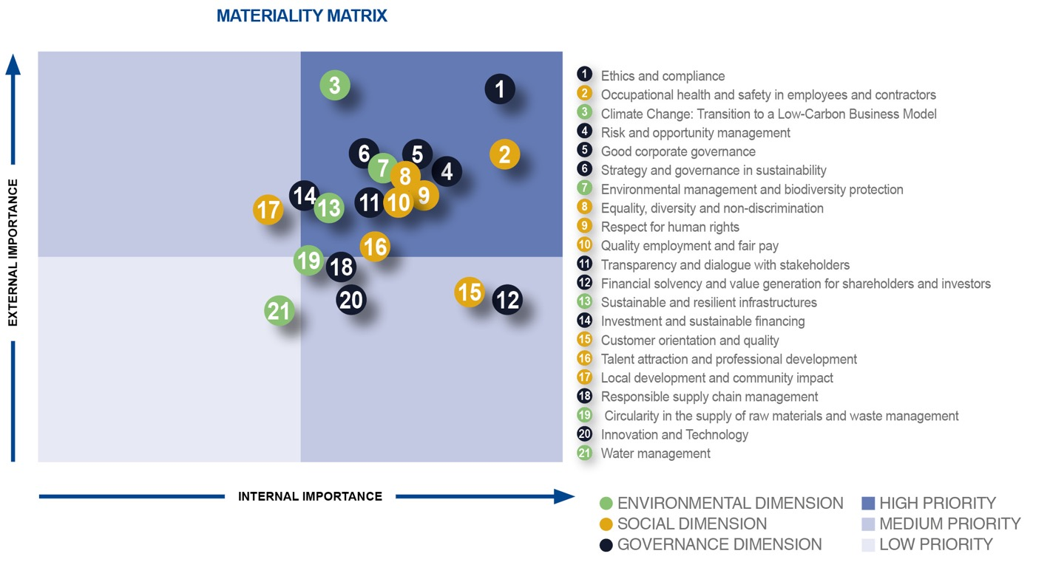
Sustainable procurement – pulse check and strategy development
Materiality analysis of the ACS Group
Sprint
  In accordance with the principles of the GRI Standards for determining the content of the 2021 Integrated Report, the ACS Group conducted a materiality analysis to identify the relevant topics.
  In this context, the materiality analysis was used as a starting point for the ACS Group's strategic considerations on sustainability (Sustainability Master Plan 2025).
Grupo ACS is a publicly traded Spanish construction group based in Madrid. ACS is one of the largest construction companies in Europe.
The GRI standard refers to the Global Reporting Initiative (GRI), which promotes sustainability reporting by organizations worldwide.

